Slide 1
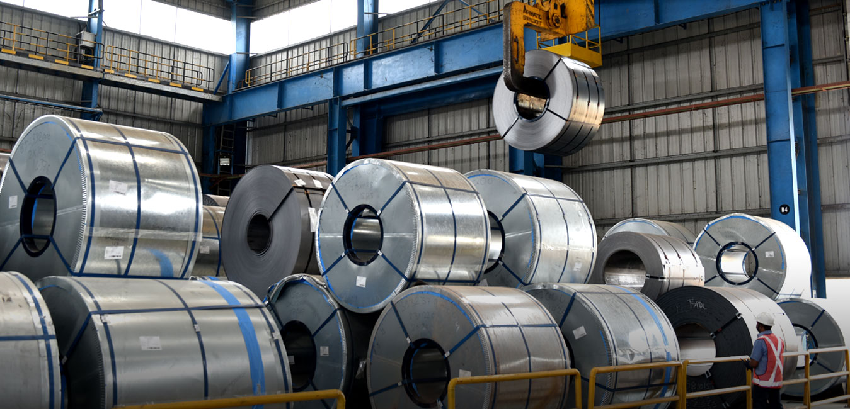
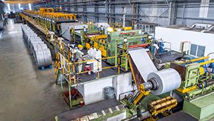
CAPSTONE PROJECT -Integrated Electrical Maintenance Equipment Analysis (2018-2021)
Business in Brief:
Data is collected for a Cold Roll Mill of TATA STEEL, CRM produces steel sheets for various applications like automobile skin panel, corrugated sheets ..etc .
An Electrical agency maintains and fix any abnormality of electrical equipment and automation systems. It is also responsible for upgrades and commissioning of new systems introduced for increasing efficiency of the process.

Slide 2
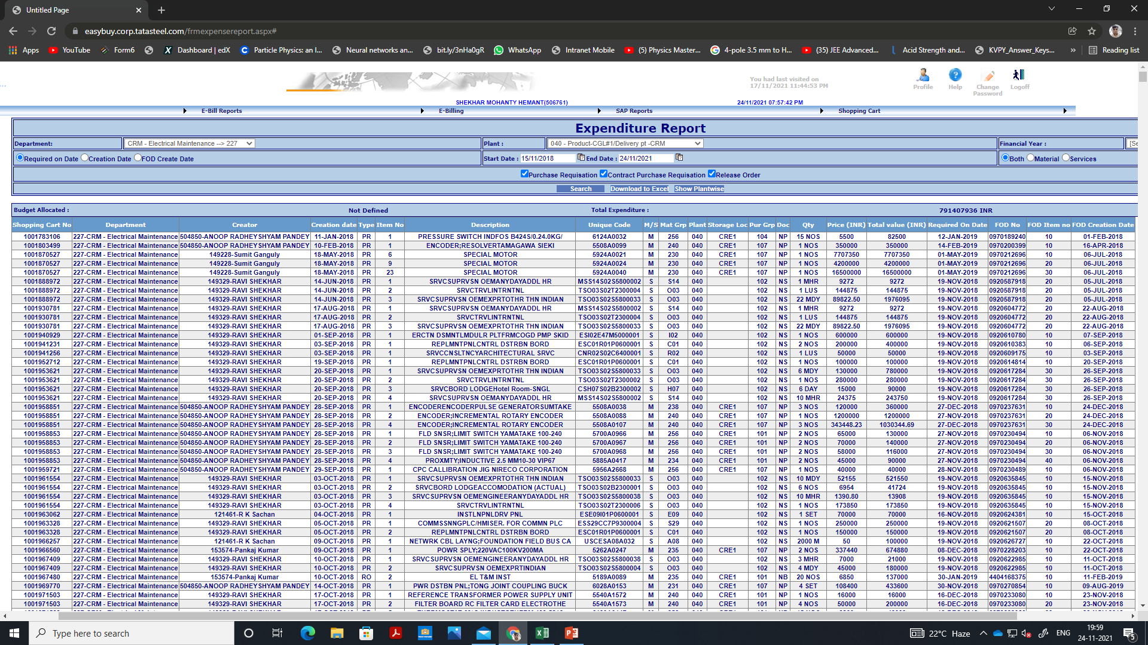
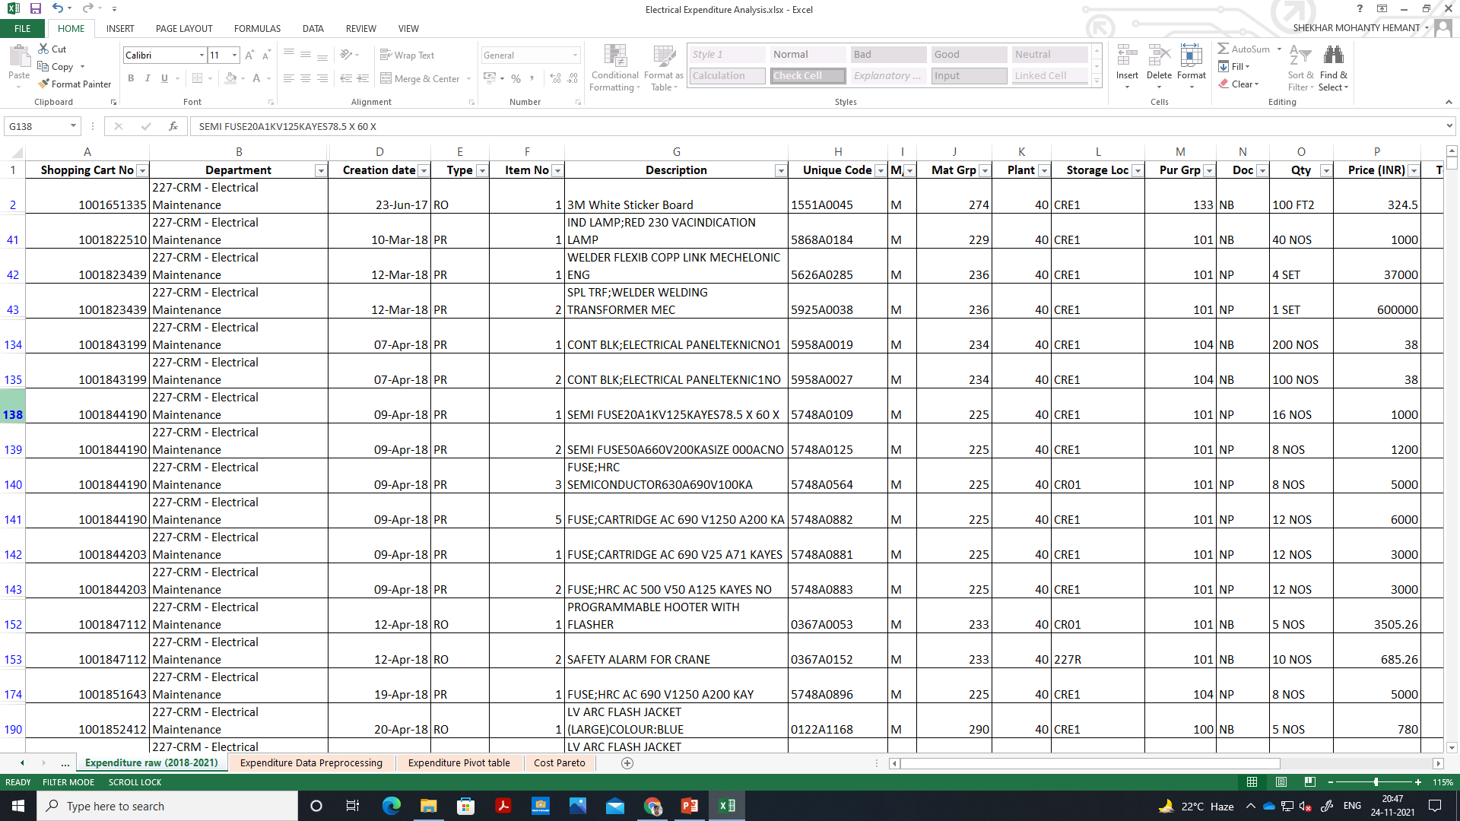
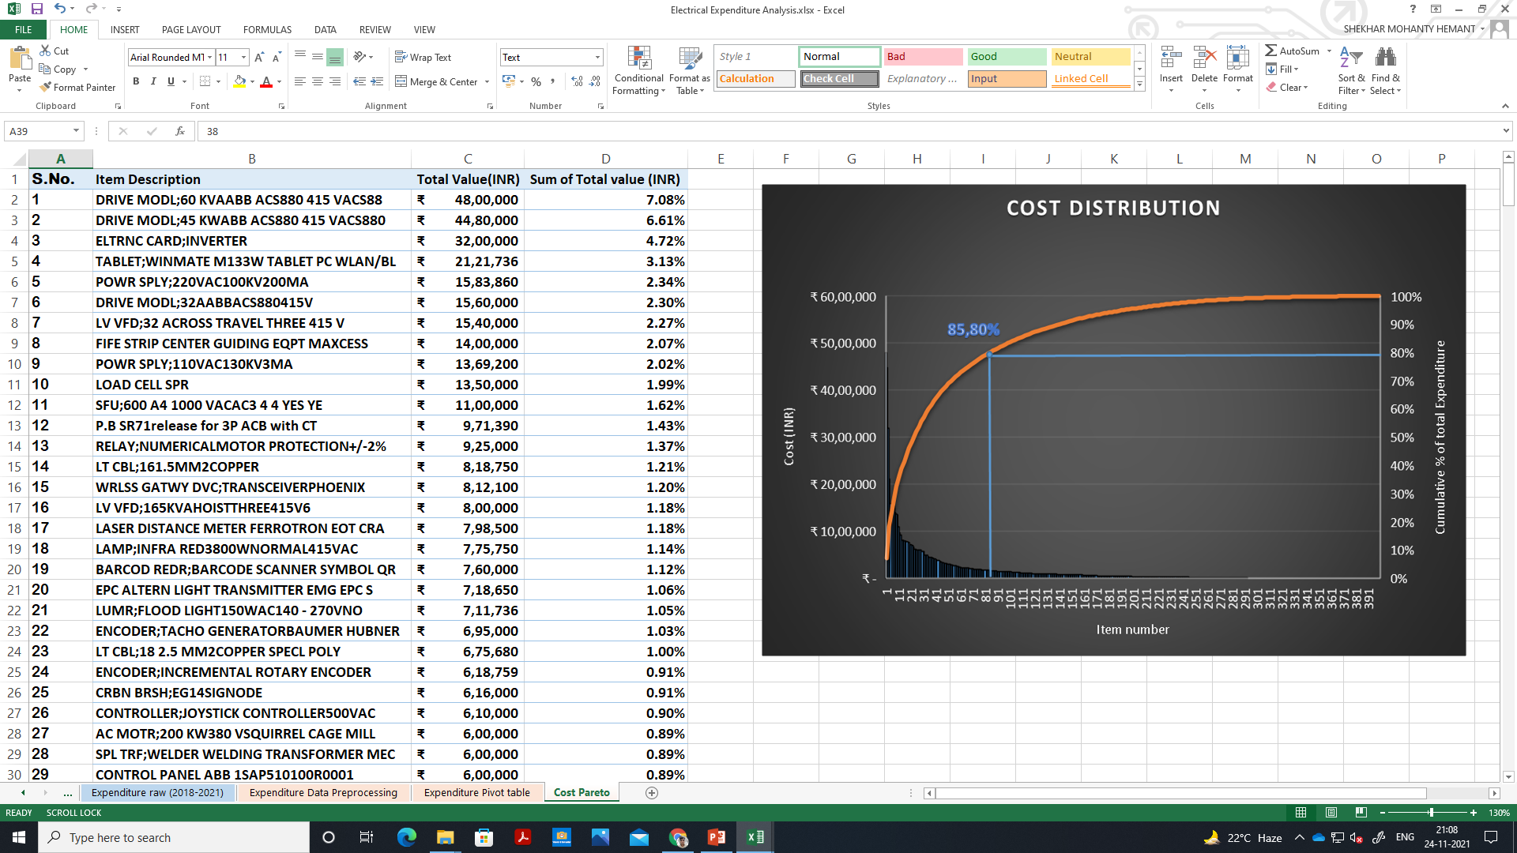
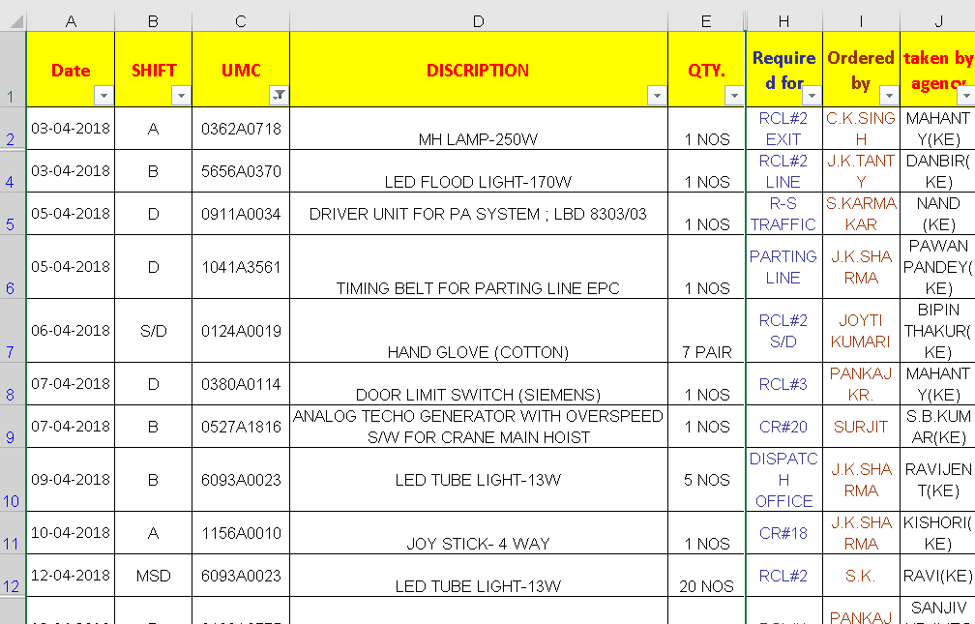
Data- Collection
RAW DATA FROM ERP SYSTEM
PRE-PROCESSING
CONSOLIDATED IN PIVOT TABLES
RAW DATA FROM STORE
Raw data from ERP system of Expenditure and store incoming/outgoing records of Electrical maintenance equipment over past 3 years of my department was exported in excel, pre-processing includes filtering/converting raw data and deleting non electrical items.
I learned and used GitHub to maintain and work on my project from both home and office.

Slide 3
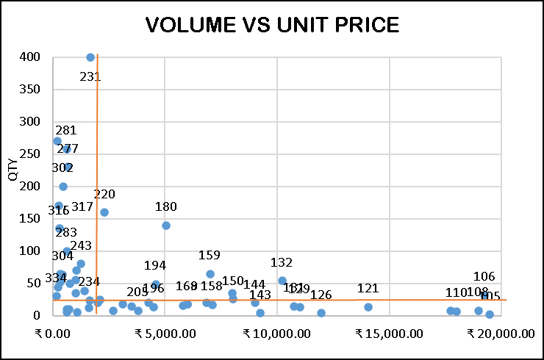
Analysis (Graphs and Charts) and interpretation
Top items in first quadrant
I
#All these items are ordered more than once
Top items in store outgoing records.
From 1st quadrant of portfolio analysis that is plotting volume of items bought vs per unit price and then dividing regions using median of data, we get get an approximation of items which fail most often.
We can also verify this result by analysing the data of store outgoing stock entered manually by the store keeper.

Slide 4
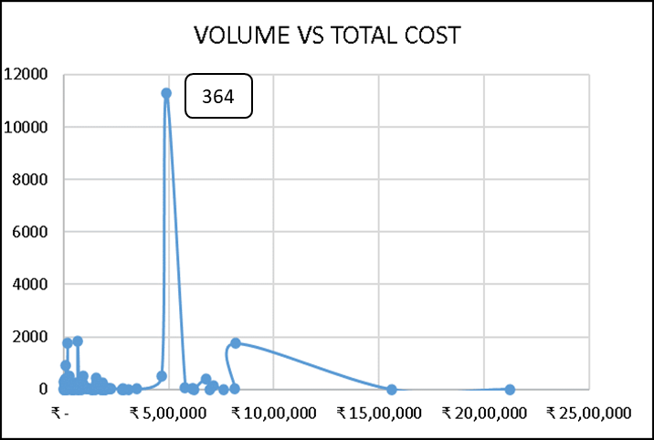
Analysis (Graphs and Charts) and interpretation
Looking at expenditure distribution from a different metric that is Average Days of order which is the average number of days between successive order, we find that temperature stickers are also being used excessively.
1
2
3
Purchase pattern is more regular for temperature stickers.
Contribution towards total cost is in Lakhs

Slide 5
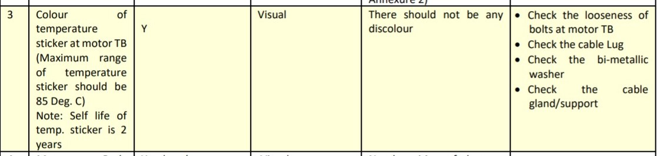
INSIGHTS AND RECOMMENDATIONS
There are items which are both costly and high failure rate or rate of consumption which needs to be replaced with a better alternative.
Due to manual entry in store records and low price per unit there are some items whose consumption stay hidden, Temperature sticker is one such item. Replacement time of temperature stickers should be increased and should be used at motor TB only.
A proper store stock record system needs to be prepared.
Reference:- Standard maintenance guide.

